Slide 1


Protractor-Advance
Prepared By: Shrish Tripathi

Slide 2


Headless mode

Slide 3


Slide 4
Using rest api in protractor tests

Slide 5


Slide 6


Slide 7
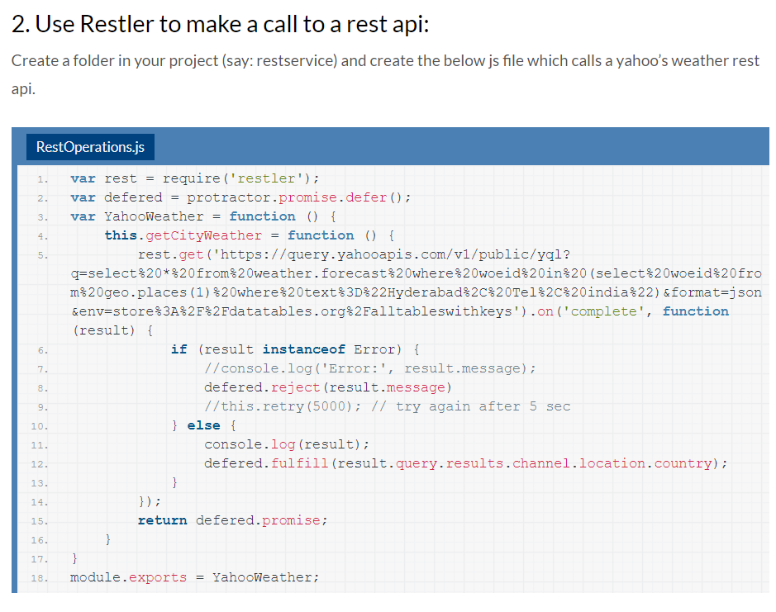


Slide 8
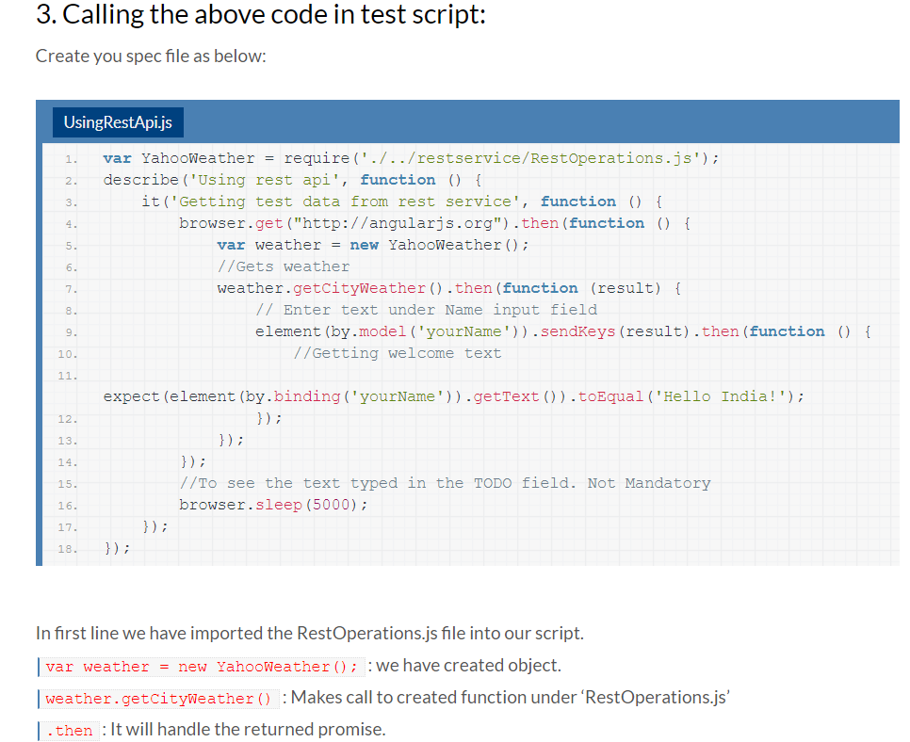

Slide 9
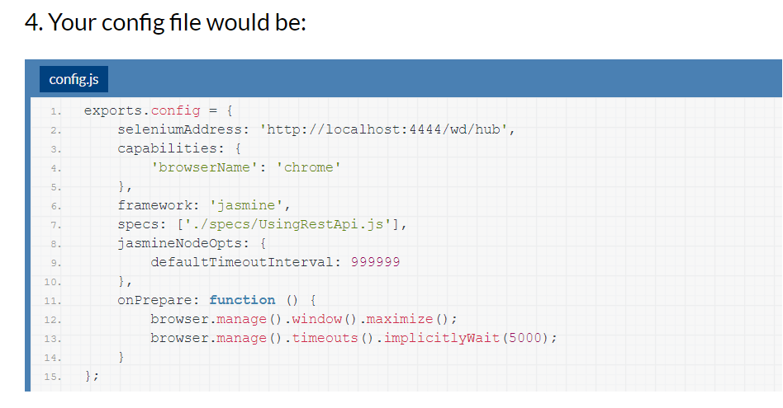

Slide 10
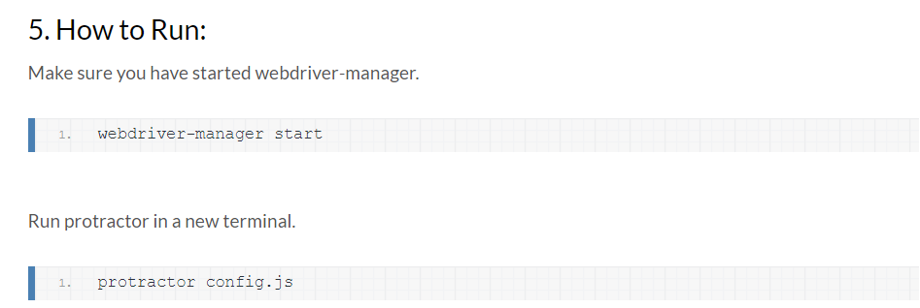

Slide 11
More on API Testing by Protractor

Slide 12
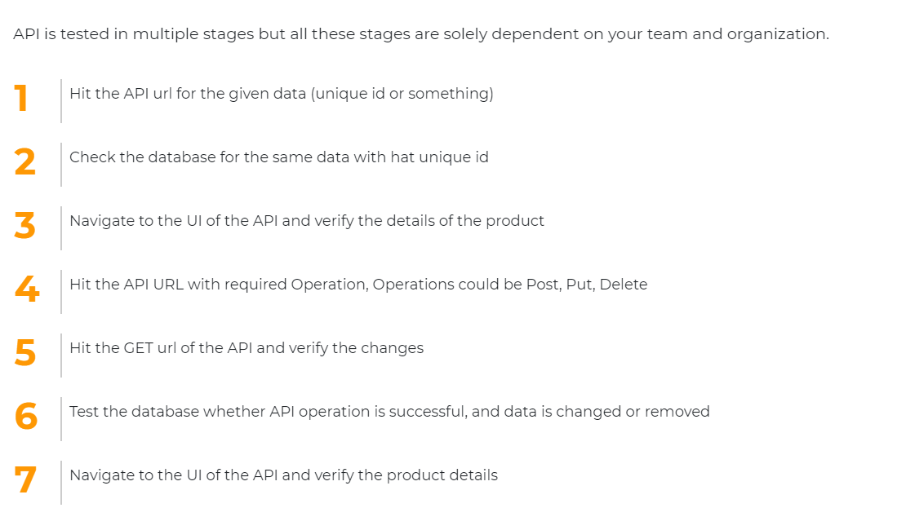

Slide 13
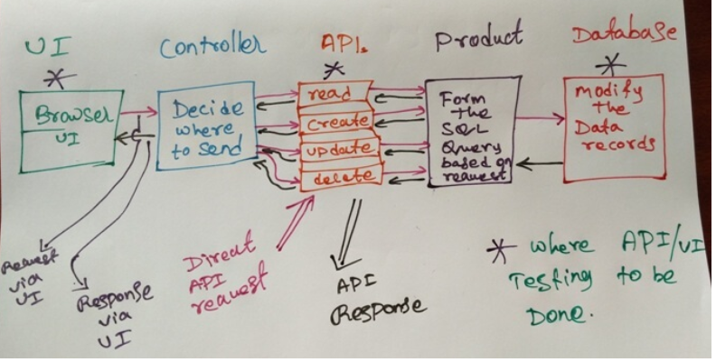

Slide 14
Sample APISample API for GET all : https://chercher.tech/sample/api/product/read Sample API for GET Specific: https://chercher.tech/sample/api/product/read?id=90 Sample API for PUT : https://chercher.tech/sample/api/product/create Sample API for POST : https://chercher.tech/sample/api/product/update Sample API for DELETE : https://chercher.tech/sample/api/product/delete
Sample API’s

Slide 15


Slide 17



Slide 18
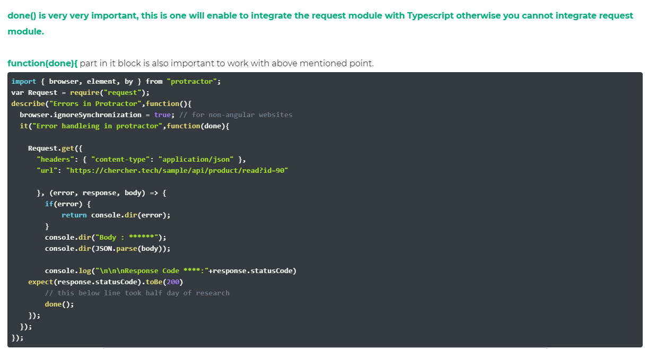

Slide 19
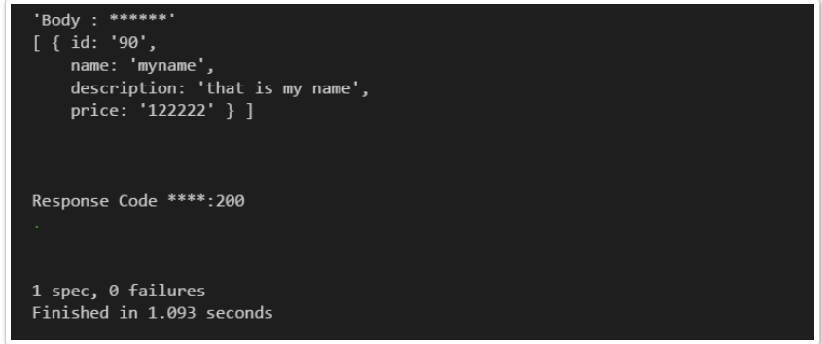

Slide 20
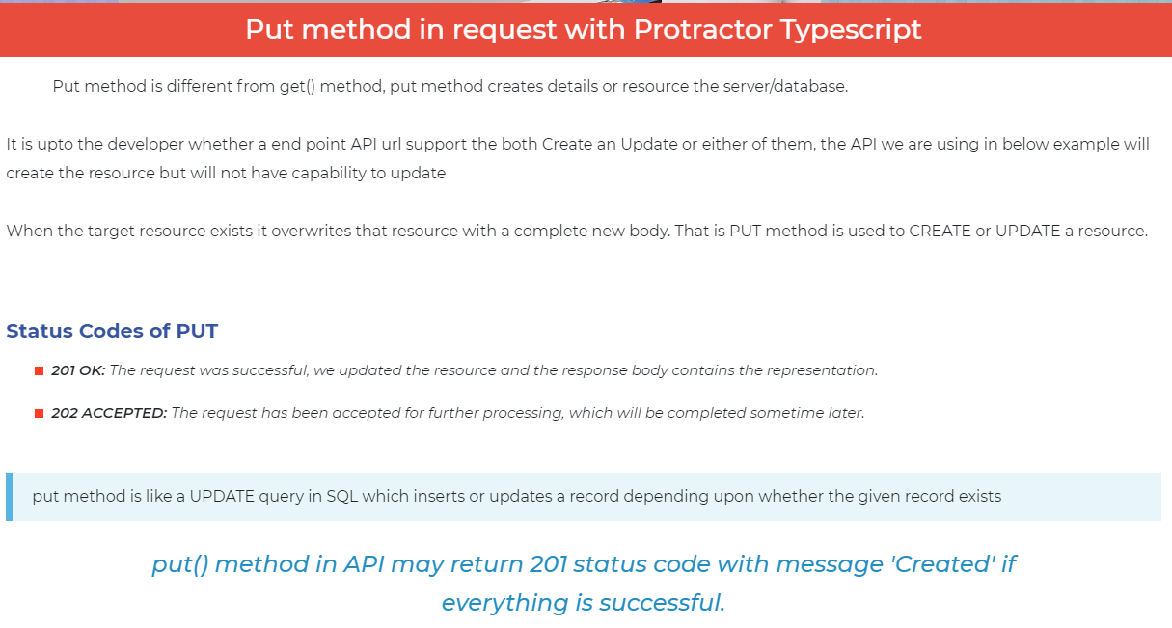

Slide 21
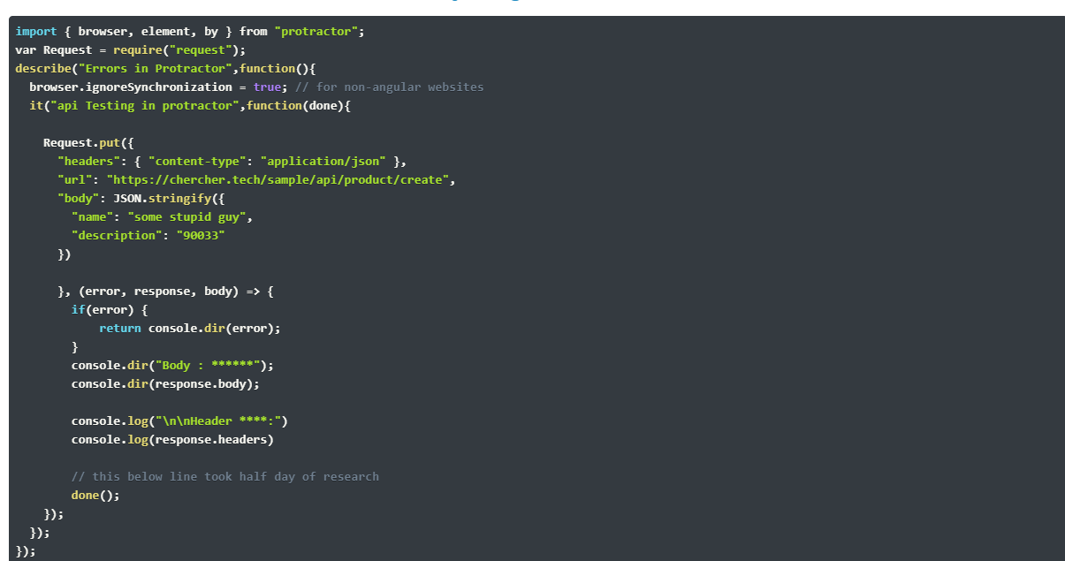

Slide 22
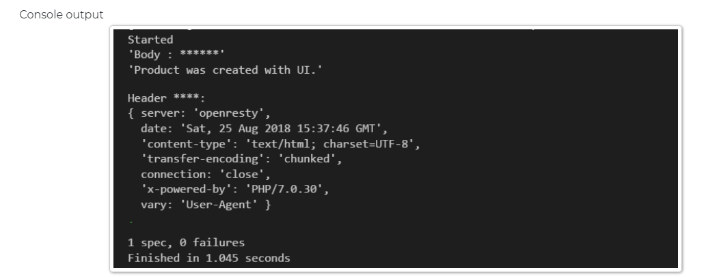

Slide 23
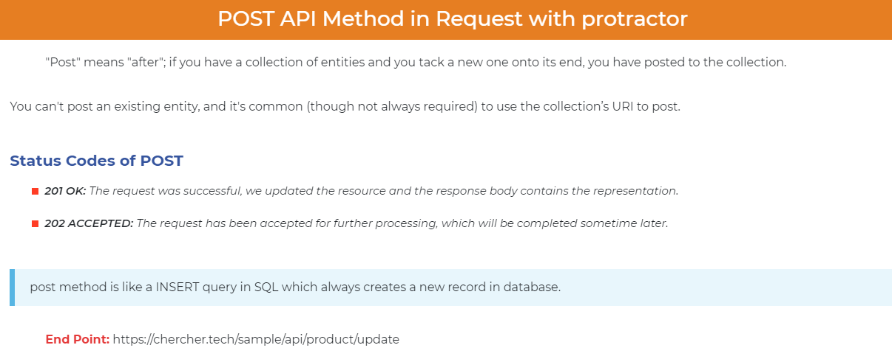

Slide 24
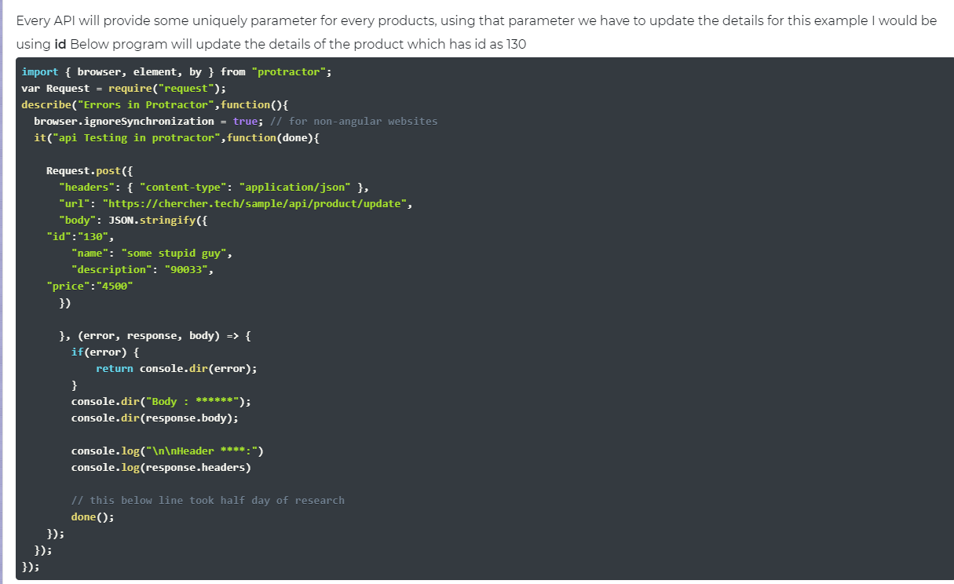

Slide 25
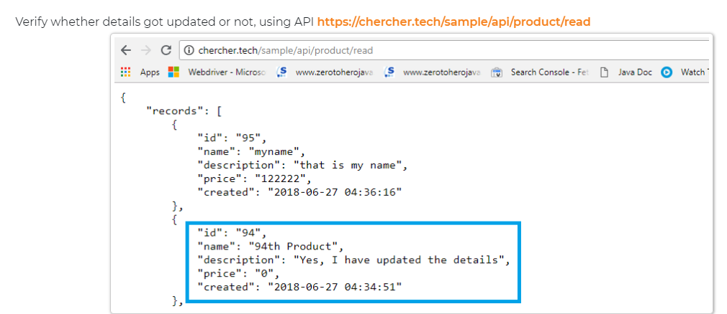

Slide 26


Slide 27
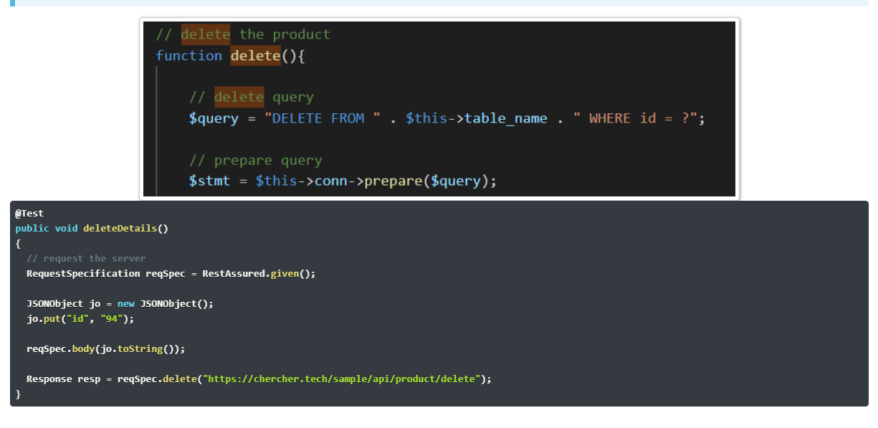

Slide 28
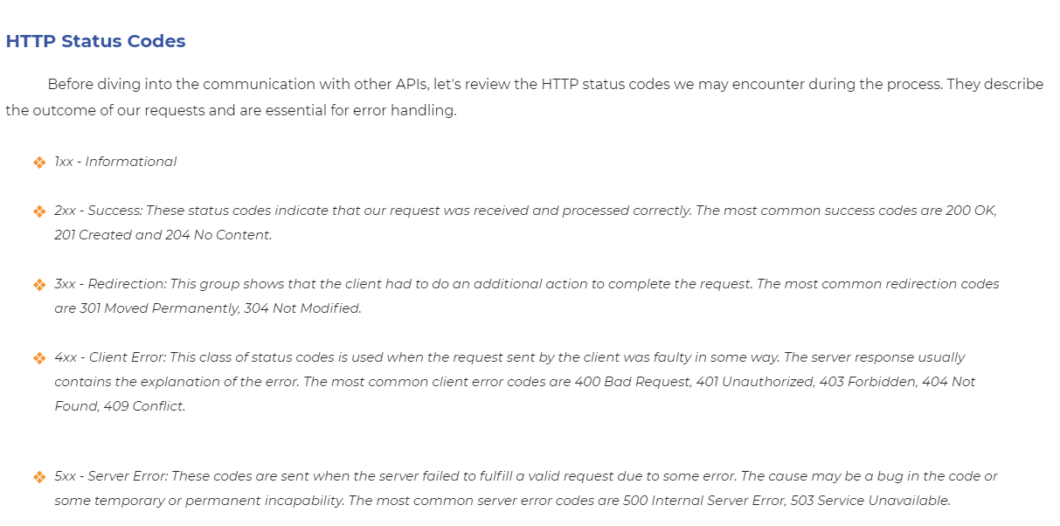

Slide 29

Comparison Webdriver Vs WebdriverJS

Slide 30
Protractor Plugins

Slide 31
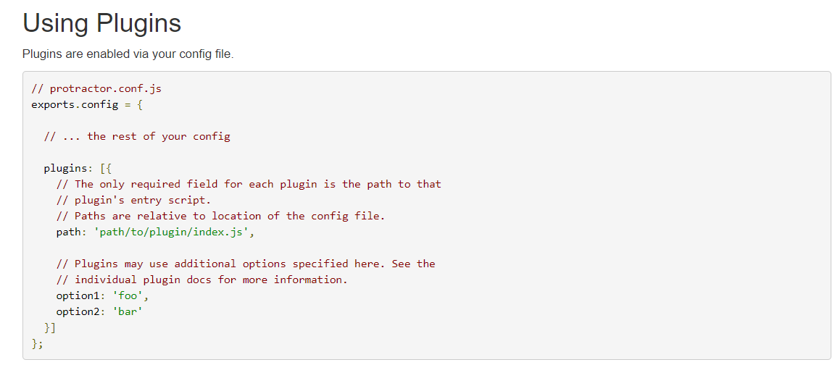

Slide 32


Slide 33
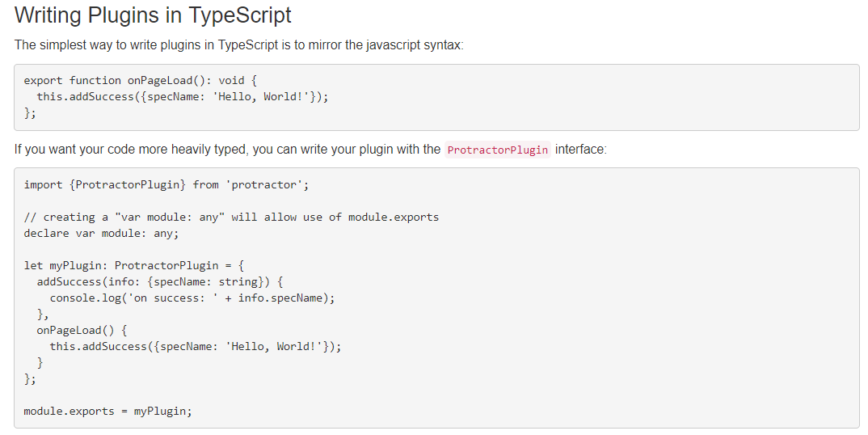

Slide 34


Slide 35



Slide 36


Slide 37


Slide 38



Slide 39



Slide 40


Slide 41

webdriver-manager update --android

Slide 42
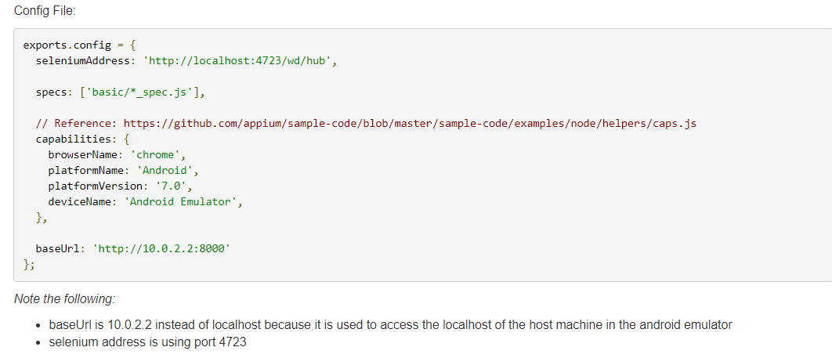

Slide 43


Slide 44
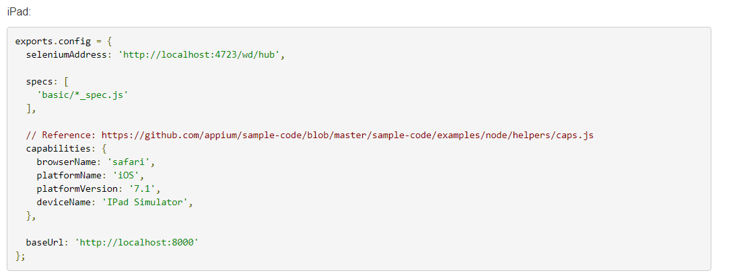

Slide 45
Thanks

